Slide 1
Accessibility: What it is and why it is essential for some but beneficial for all

Slide 2
CAST Mission and Goals
CAST has a singular ambition: Bust the barriers to learning that millions of people experience every day.
We do this by helping educators and organizations apply insights from the learning sciences and leading-edge practices to educational design and implementation.

Slide 3
Universal Design for Learning (UDL)
A framework based on scientific insights into how humans learn that seeks to optimize instruction in order to allow every person to become an expert learner. UDL: The UDL Guidelines (cast.org)
Notes:
To support the practical implementation of the UDL Principles, CAST developed the UDL Guidelines. Each of the principles has 3 guidelines that are broken down into 3-5 checkpoints
http://udlguidelines.cast.org/

Slide 4
The Curb Cut Effect (Blackwell, 2017)
Seat belts
Affirmative Action
Airline Smoking Ban
Bike Lanes
What is essential for some is almost always useful for all
Notes:
Image: Attribution 2.0 Generic by Sidewalk Sam (CC BY 2.0)
Blackwell, A.G. (2017, Winter). The Curb-Cut Effect. Stanford Social Innovation Review. Retrieved from https://tinyurl.com/y9gcmybg

Slide 5
A-11-Y in Context of UDL

Slide 6
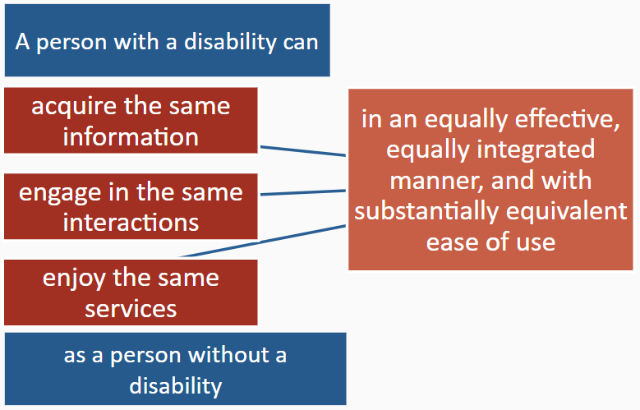
Accessibility as Defined by the U.S. DOE/Office for Civil Rights
Notes:
2010 DCL: https://www2.ed.gov/about/offices/list/ocr/letters/colleague-20100629.html

Slide 7
Accessible Materials and Technologies
Accessible Material
Is information or content
Designed or enhanced in a way that makes them usable by the widest possible range of learner variability regardless of format
Print, digital, graphical, audio, video
Accessible Technology
Is hardware or software that delivers the content
Usable by people with a wide range of abilities and disabilities
Directly usable without assistive technology (AT) or usable with it
Source: accessibletech.org

Slide 8
Material-Technology in “Accessible Harmony”
Example: A student reads an accessible website on a tablet with built-in options for access:
Display customization
Text to speech
Screen reader
Enabled with:
Bluetooth (Braille Display)
Closed captions
Video description

Slide 9
POUR on the Accessibility with WCAG
Web Content Accessibility Guidelines 2.1
Notes:
Photo credit: Credit: Jenny Downing on Flickr/CC BY 2.0
 Perceivable: Information and user components must be presentable to users in ways they can perceive. This means that information must be able to be perceived by everyone.
 Operable: User interface components and navigation must be operable. This means that the interface cannot require interaction that a user with a disability cannot perform.
 Understandable: Information, as well as the operation of the user interface, must be understandable. This means that all users must be able to understand the information and the operation of the user interface.
 Robust: Content must be robust enough that it can be interpreted reliably by a wide variety of user agents (such as browsers), including assistive technologies. This ensures that your content remains accessible as technologies evolve.

Slide 10
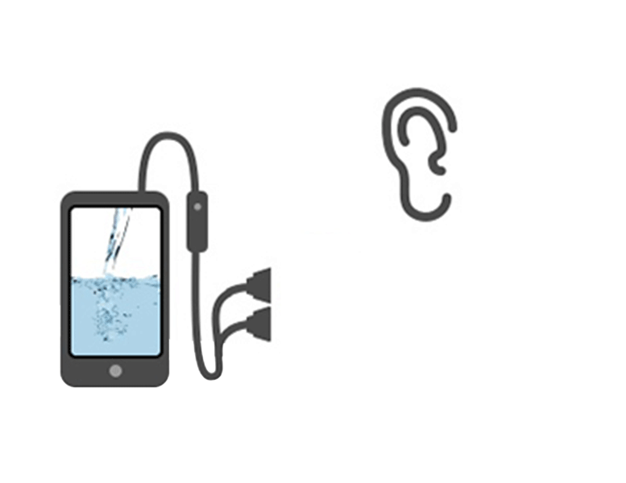
POUR: Perceivable
Can everyone see and hear the content?
How: Include alternative text for visuals, captions and transcripts for videos
Notes:
Photo credit: Credit: Jenny Downing on Flickr/CC BY 2.0

Slide 11
Video Scenario
Content: Physics
Format: Video
Scenario: Instructor video records a lecture and uploads it to the schools’ YouTube channel for students’ use.
Notes:
See https://www.youtube.com/watch?v=JPMQqlPKp-g

Slide 12
Video with No A11y
The video is posted without captions.
Notes:
See https://www.youtube.com/watch?v=JPMQqlPKp-g

Slide 13
Video with Bad A11Y
Students turn on auto caption in YouTube

Slide 14
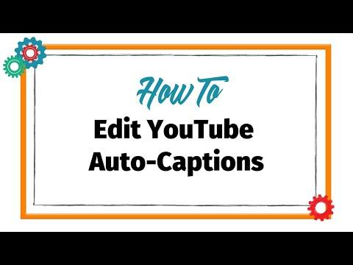
POUR on the A11Y with Captioning: YouTube

Slide 15
Image Scenario
Content: Chemistry
Format: Image
Scenario: Instructor inserts a graph in a lecture slideshow, which is provided ahead of class for students to review.
Notes:
Source: https://pixabay.com/vectors/view-cell-information-close-48543/
License: https://pixabay.com/service/license/

Slide 16
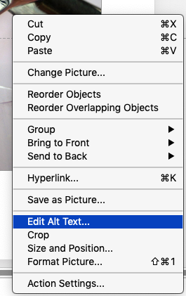
Add Alternative Text (Office 365)
Right-click on image and choose Edit Alt Text.
Enter your description manually or select “Generate a Description for Me” to use Artificial Intelligence
Alternative: Select “Mark as decorative” if the image is not required for understanding

Slide 17
From bad to good A -11-Y

Slide 18
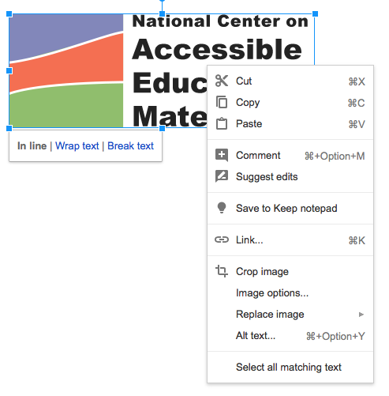
Add Alternative Text in GSuite
Right-click an image.
Select Alt text.

Slide 19
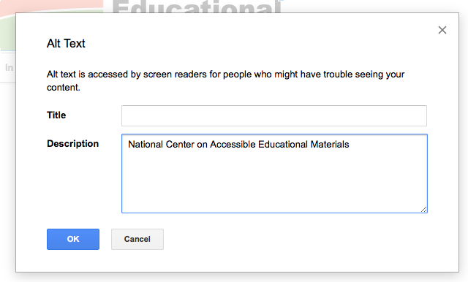
Add Alternative Text in GSuite (2 of 2)
3. Type a description for the image in the Description text field.
Note: Do not use the Title text field

Slide 20
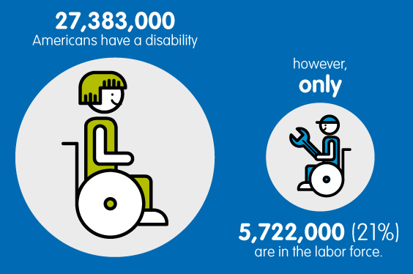
Model: Alt text for an Infographic
Alt text: Only 21% of
Americans with disabilities
are in the labor force.
Slide text should accompany this image:
27,383,000 Americans have
a disability. However, only
5,722,000 (21%) are in the
labor force.
Ideally, there would also be a long description embedded in the image — a more complete and literal description of the image.
Notes:
An infographic about Americans with disabilities. On the left, there is a large circle with an illustration of a person dressed in green in a wheelchair. On the right, there is a smaller circle with an illustration of a person dressed in blue holding a wrench in a wheelchair.
Twenty seven million, three hundred and eighty three thousand Americans have a disability. However, only five million seven hundred and twenty two thousand are in the labor force.

Slide 21
POUR: Operable
Can everyone navigate the content with ease?
How: Use styles for section headers, create descriptive links
Notes:
Photo credit: Credit: Jenny Downing on Flickr/CC BY 2.0

Slide 22
Benefits of Using Styles
Provide in-page navigation for screen reader users
Supports executive functioning by revealing the structure of the document
Create a table of contents from styles
Ensures consistency (change style once to see changes cascade through document)

Slide 23
Mark up the document with styles
Apply styles to indicate section headings (should be descriptive and unique)

Slide 24
Styles should follow a logical order
Nest styles properly to provider a meaningful outline of the content.
H1 – Advanced Mathematics
H2 – Instructor Information
H2 – Course Materials
H3 - Textbook
H3 – Course Website
H2 – Major Assignments
H3 – Tests
H3 – Final Project

Slide 25
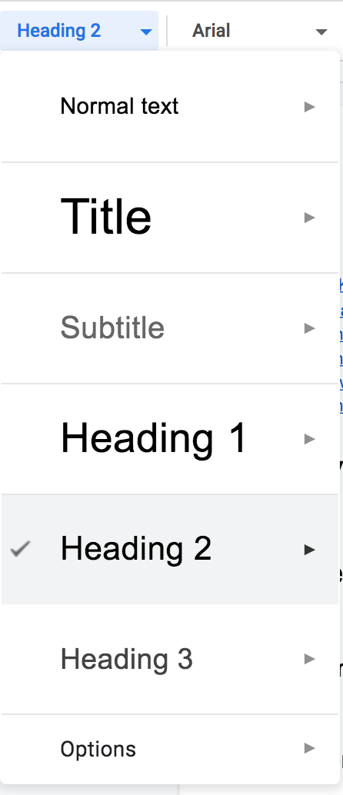
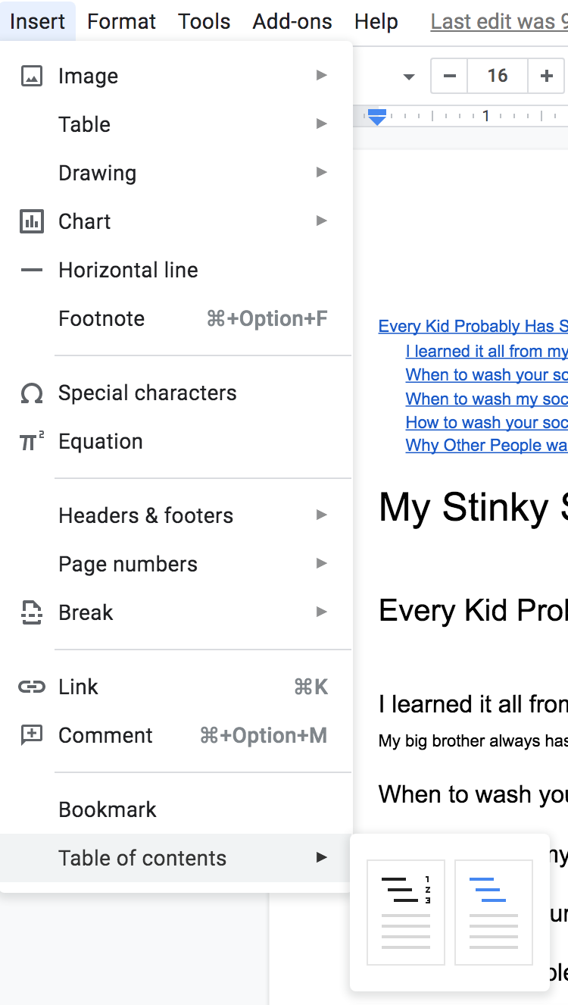
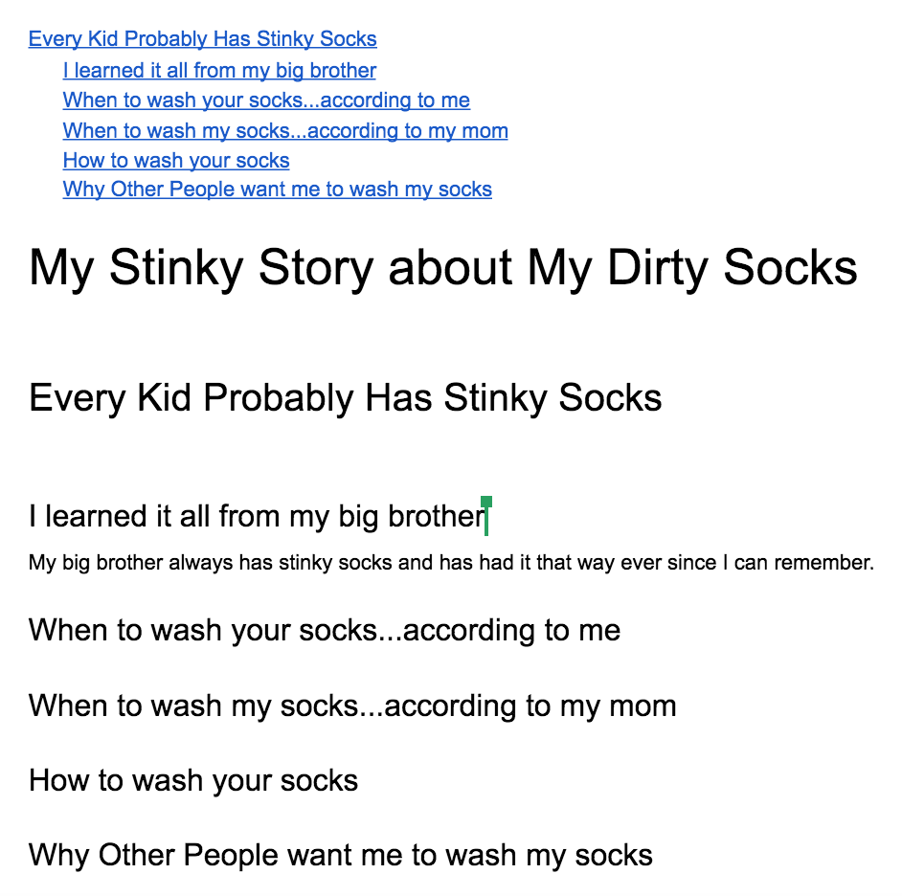
Google Doc - Benefit of Styles

Slide 26
Create descriptive hyperlinks
Screen reader users may access the links on a list, without the rest of the for context. Which of these two links takes you to the Course Website?
Click Here
Click Here

Slide 27
Let’s try that again
Let’s try that again, this time with more descriptive text. Which of these links takes you to the Course Website?
Course Textbook
Course Website

Slide 28
Avoid raw URLs
Reading the following URL would be confusing to a screen reader user:
https://docs.google.com/presentation/d/1I3lg6CSQYDw53H-b77210XYPRWt3u-iFqqD9RRD0LXY/edit?usp=sharing
Let’s make it more descriptive:
Course Syllabus (PDF)

Slide 29
Questions so Far

Slide 30
POUR: Understandable
Is the language appropriate for my audience?
How: Use plain language and check the readability level
Notes:
Photo credit: Credit: Jenny Downing on Flickr/CC BY 2.0

Slide 31
Use online tools to check readability level

Slide 32
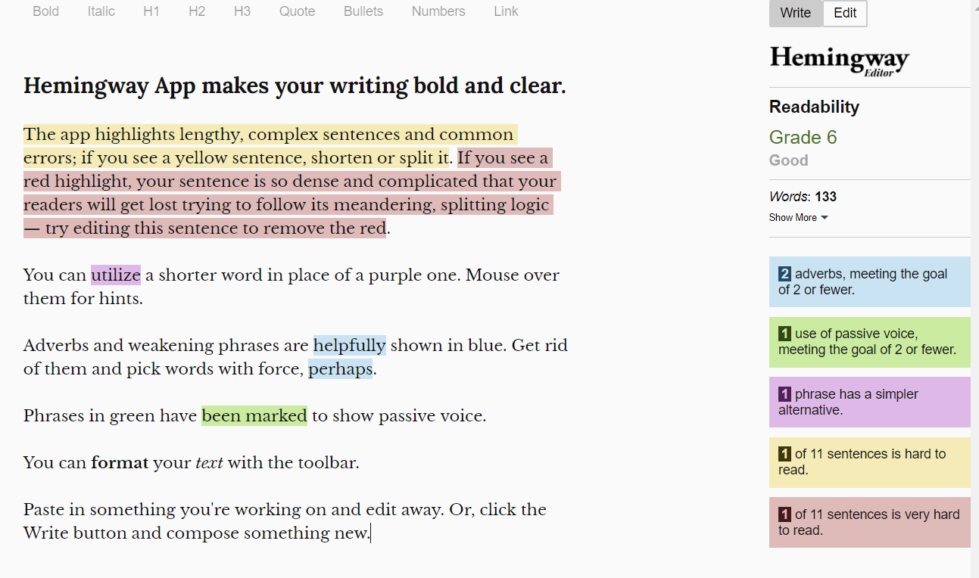
Guidance for writing

Slide 33
POUR: Robust
Does my content follow best practices?
How: Perform an accessibility check

Slide 34
Run the Accessibility Checker
Found in the Ribbon under Review.

Slide 35
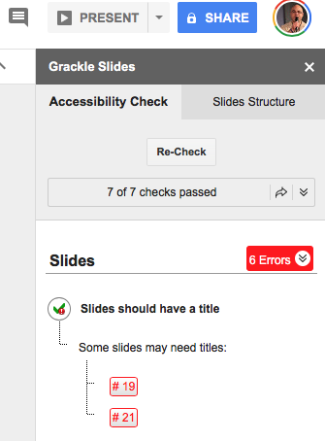
Use Grackle for Google

Slide 36
Responsive Website Design

Slide 37
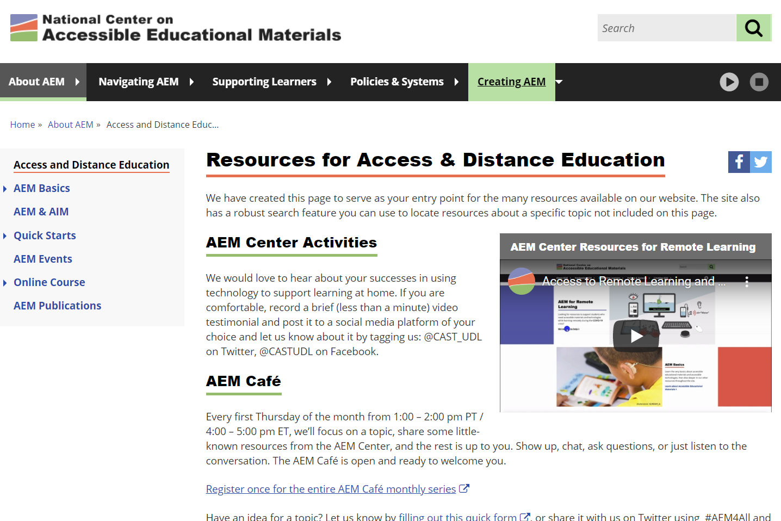
AEM Center Resources
Notes:
http://aem.cast.org/creating/designing-for-accessibility-pour.html

Slide 38
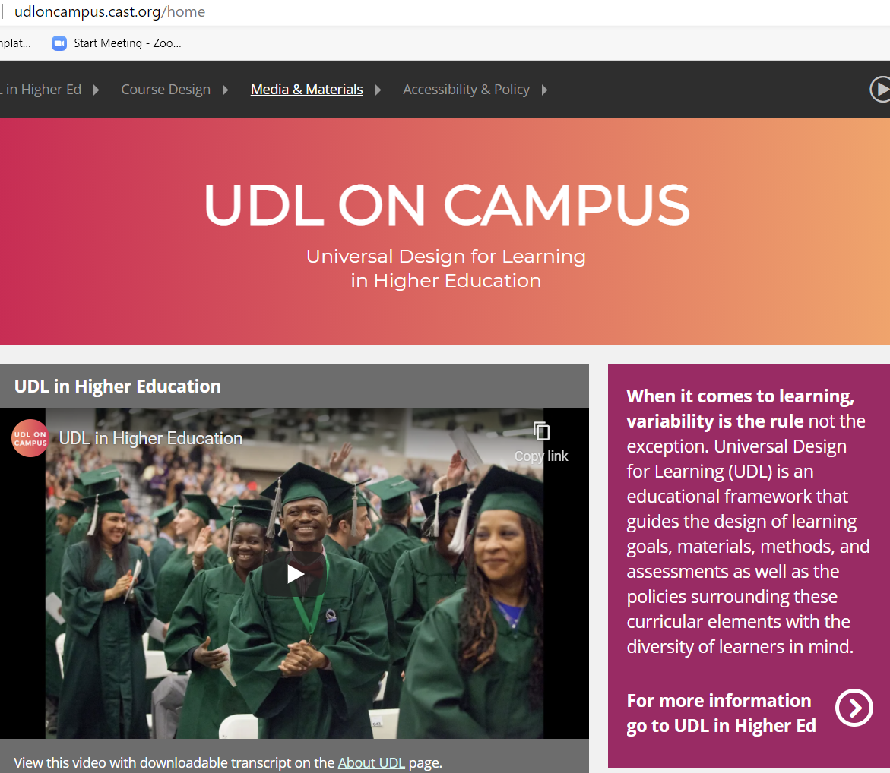
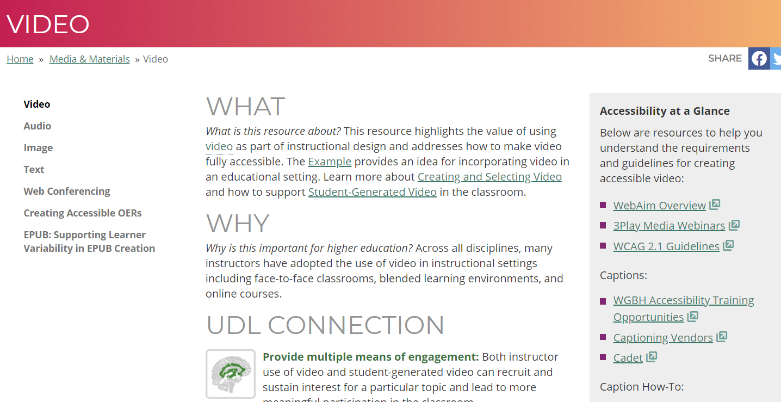
UDL on Campus

Slide 39
Other Resources
UDL Guidelines
UDL: The UDL Guidelines (cast.org)
Navigation
Keyboard and mouse alternatives and adaptations | AbilityNet
Image descriptions
WebAIM: Alternative Text
An alt Decision Tree (WAI)
DIAGRAM Center (more complex images)

